Slide 1
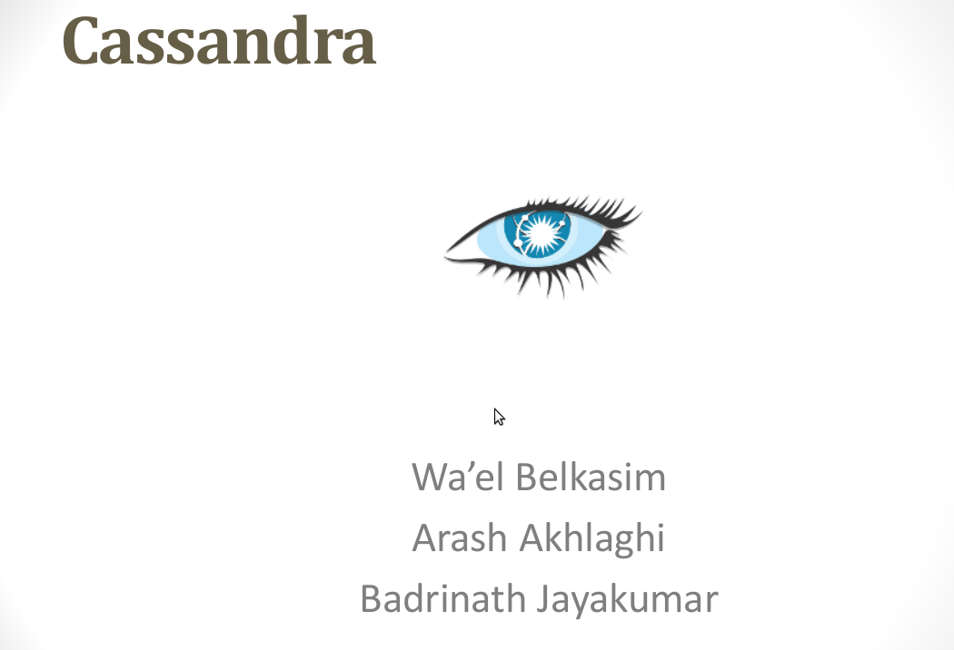
Prof. Latifur Khan
Department of Computer Science
School of Engineering & Computer Science
UT Dallas
http://jonathanhui.com/how-cassandra-read-persists-data-and-maintain-consistency

Slide 2
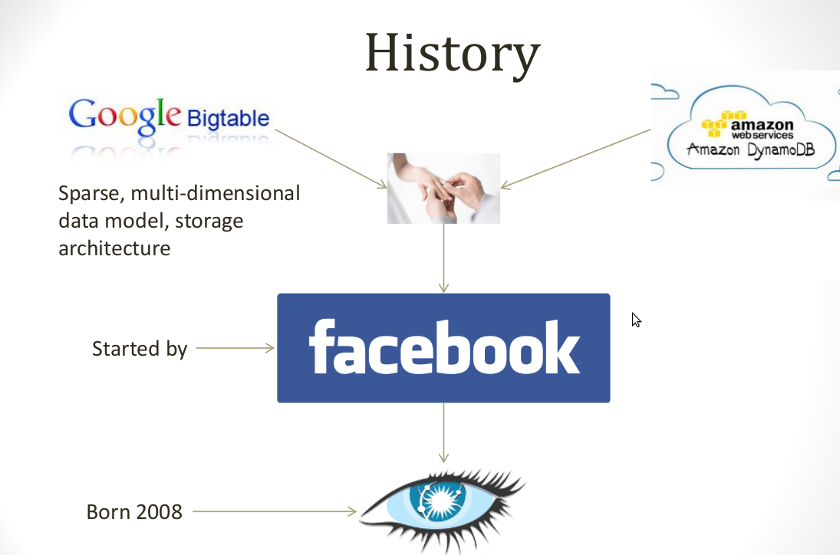

Slide 3
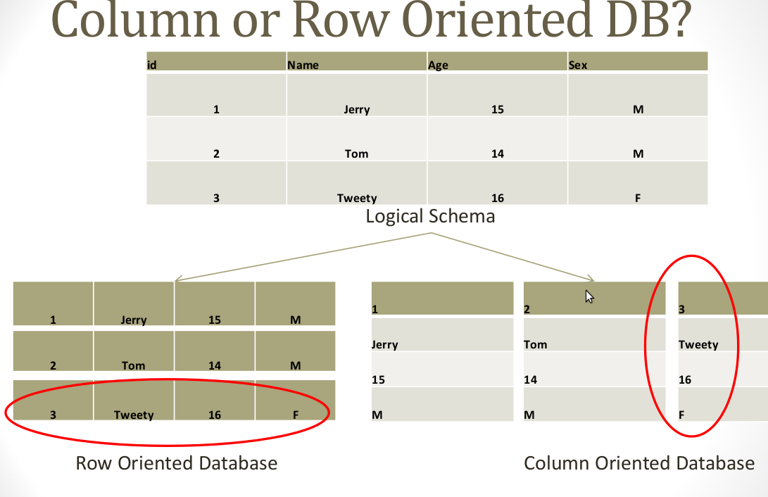
A little of both..

Slide 4
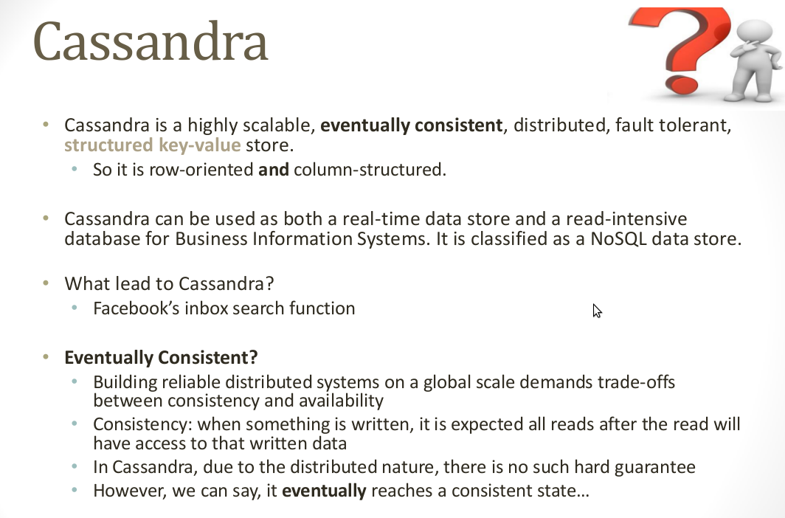

Slide 5
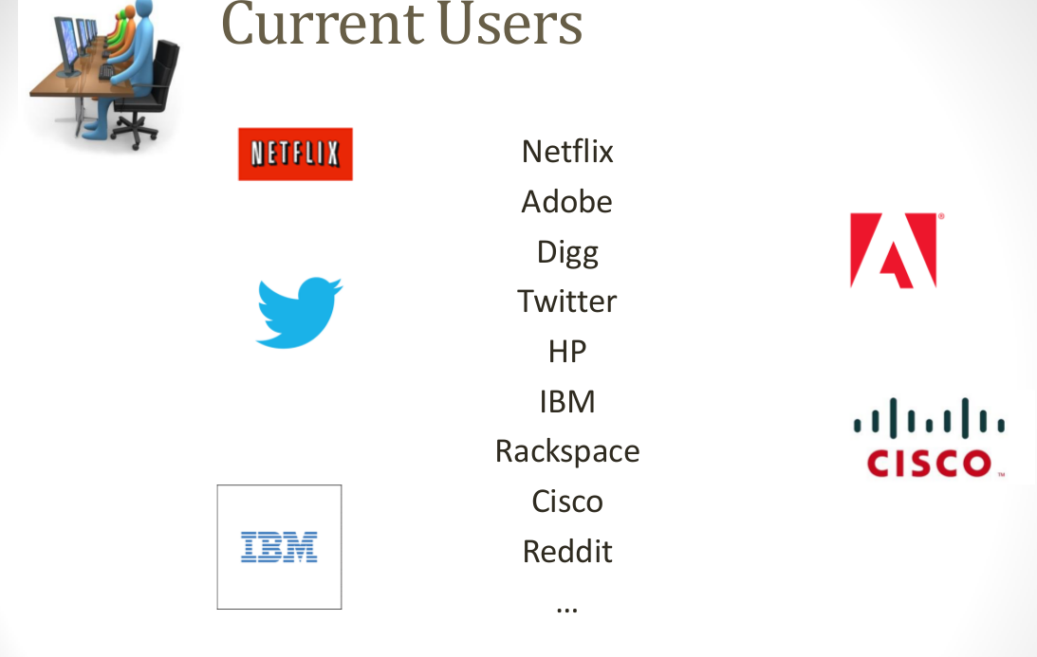

Slide 6
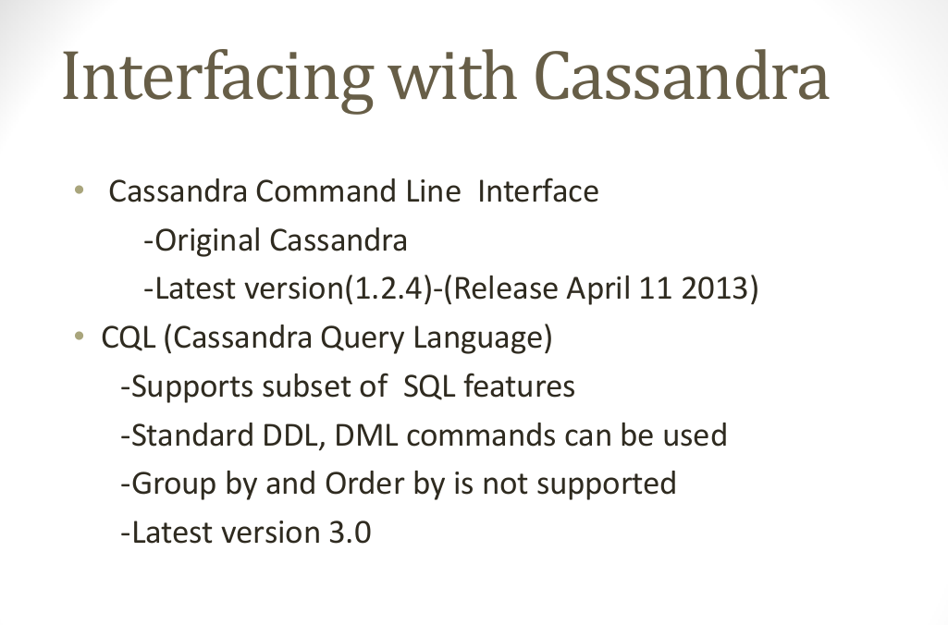

Slide 7
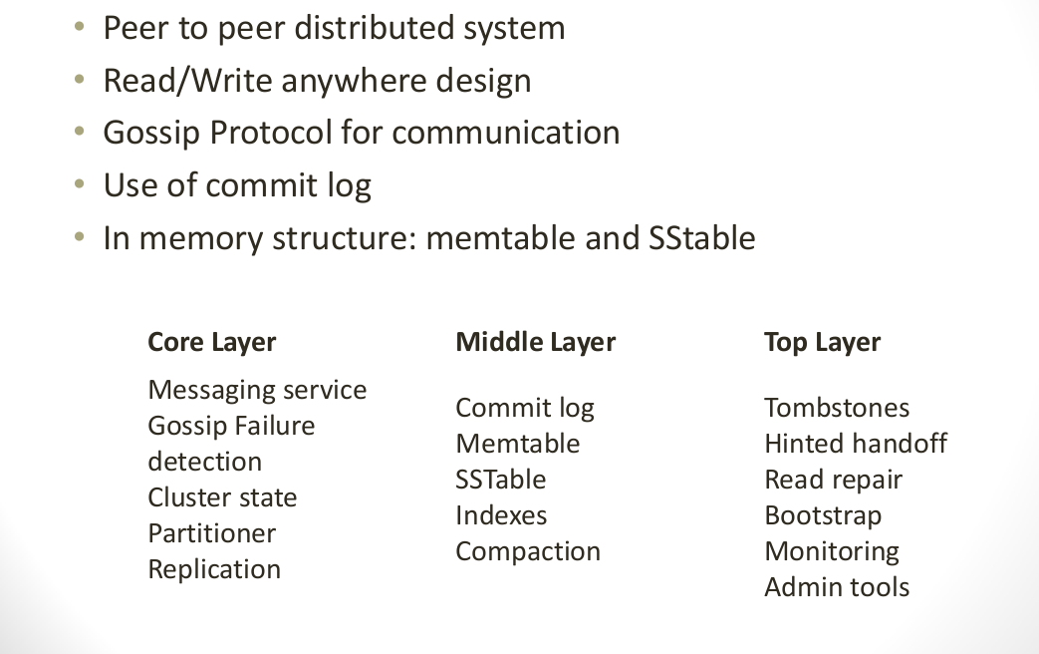
Architecture Overview

Slide 8
Membership
Cluster membership in Cassandra is based on Scuttlebutt, a very efficient anti-entropy Gossip based mechanism.
Notes:
Rey=تکیه دارد substrate = لایه؛زیرلایه stage=مرحله؛وهله

Slide 9
Membership
Gossip protocol is used for cluster membership.
Super lightweight with mathematically provable properties.
State disseminated in O(logN) rounds where N is the number of nodes in the cluster.
Every T seconds each member increments its heartbeat counter and selects one other member to send its list to.
A member merges the list with its own list .

Slide 10
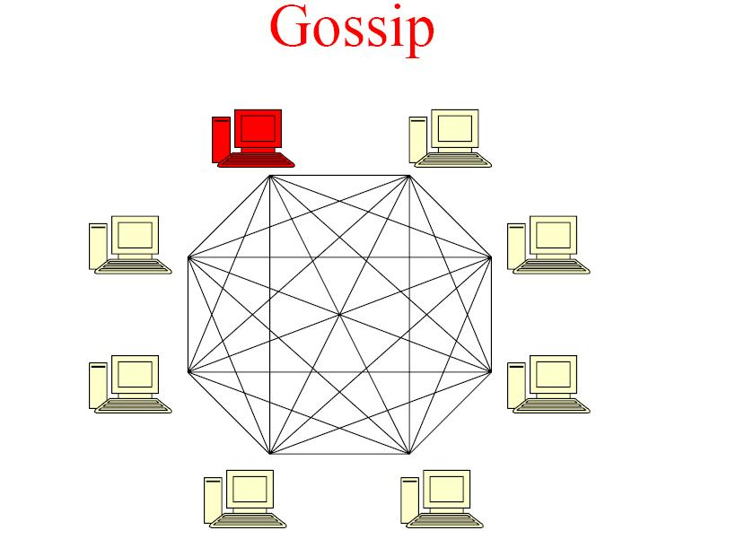

Slide 11
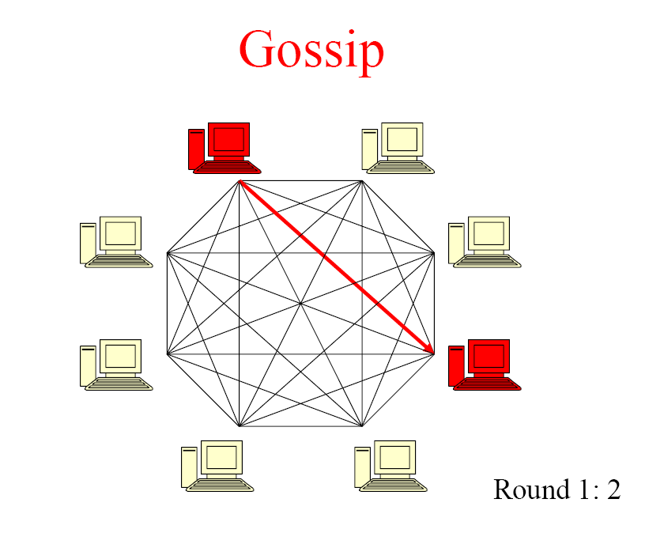

Slide 12
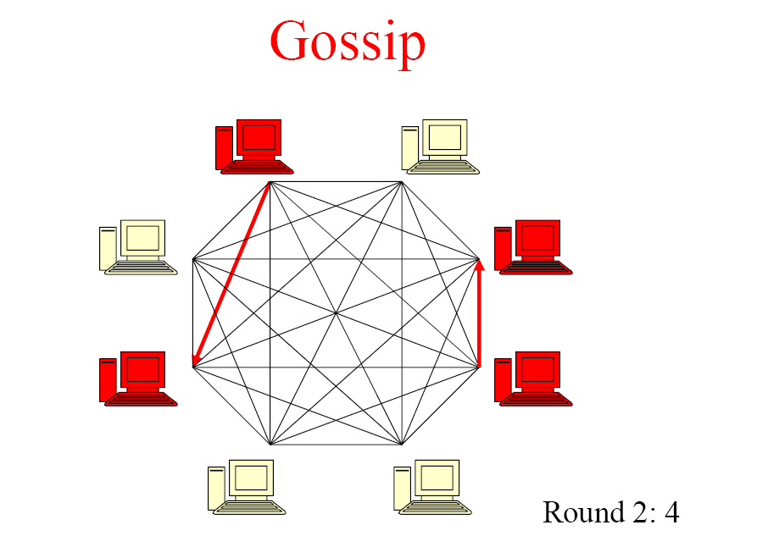

Slide 13
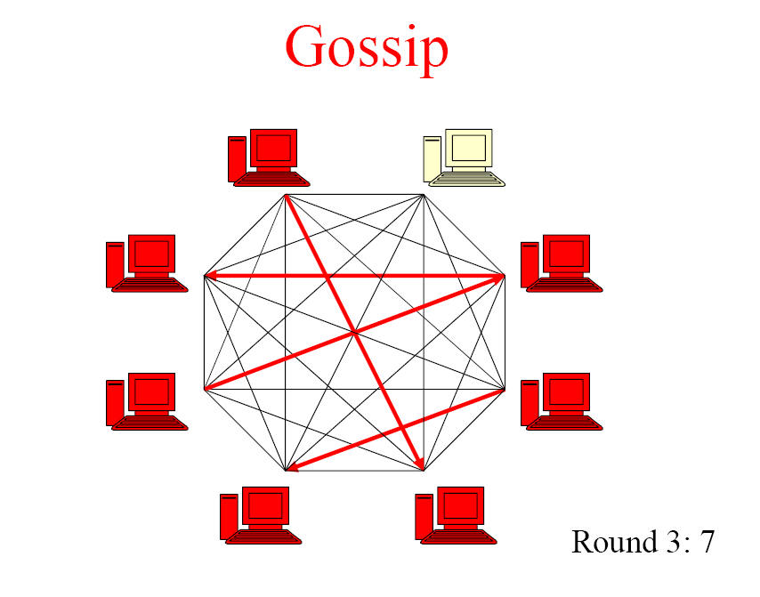

Slide 14
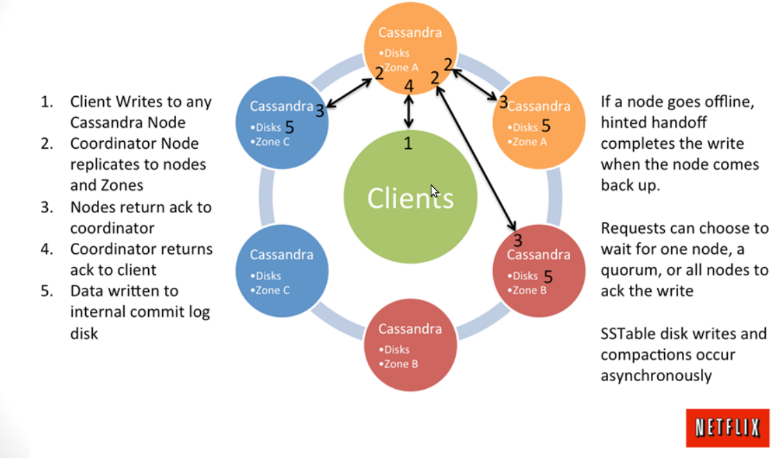
Architecture Overview

Slide 15
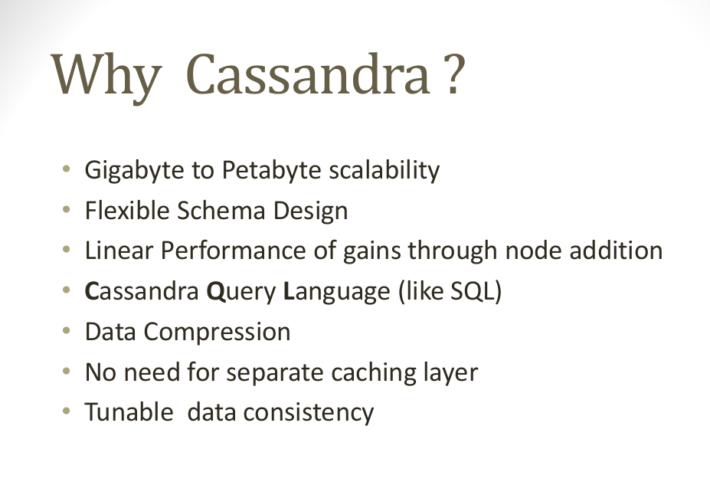

Slide 16
Data Model
A table in Cassandra is a distributed multi dimensional map indexed by a key. The value is an object which is highly structured.
Simple column families
Cassandra exposes two kinds of columns families
Super column families

Slide 17
Issues with today’s workloads
Data: Large and unstructured
Lots of random reads and writes
Foreign keys rarely needed
Need
Incremental Scalability
Speed
No Single point of failure
Low TCO and admin
Scale out, not up

Slide 18
Schema-free Sparse-table
Flexible column naming
You define the sort order
Not required to have a specific column just because another row does

Slide 19
Data Model
Keyspace
ColumnFamily
Row (indexed)
Key
Columns
Name (sorted)
Value

Slide 20
Easier to show from the bottom up

Slide 21

Data Model
A single column

Slide 22
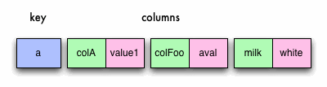
Data Model
A single row

Slide 23
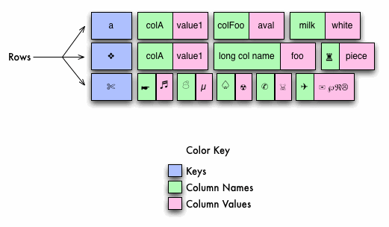
Data Model

Slide 24
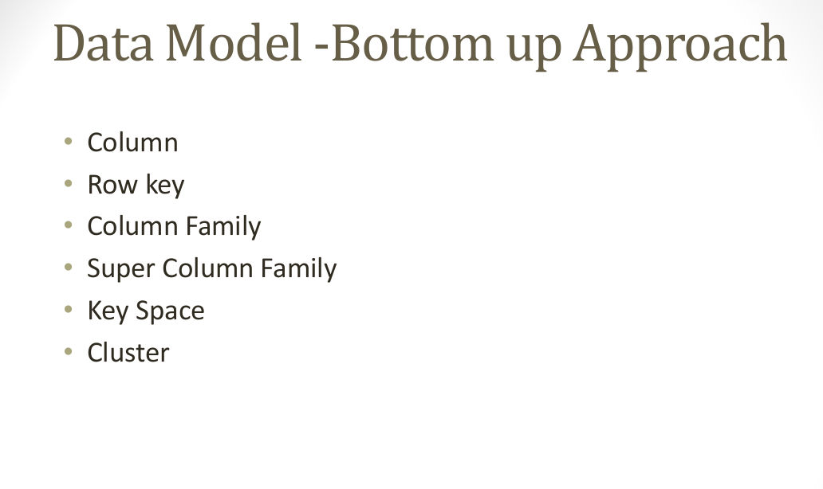

Slide 25
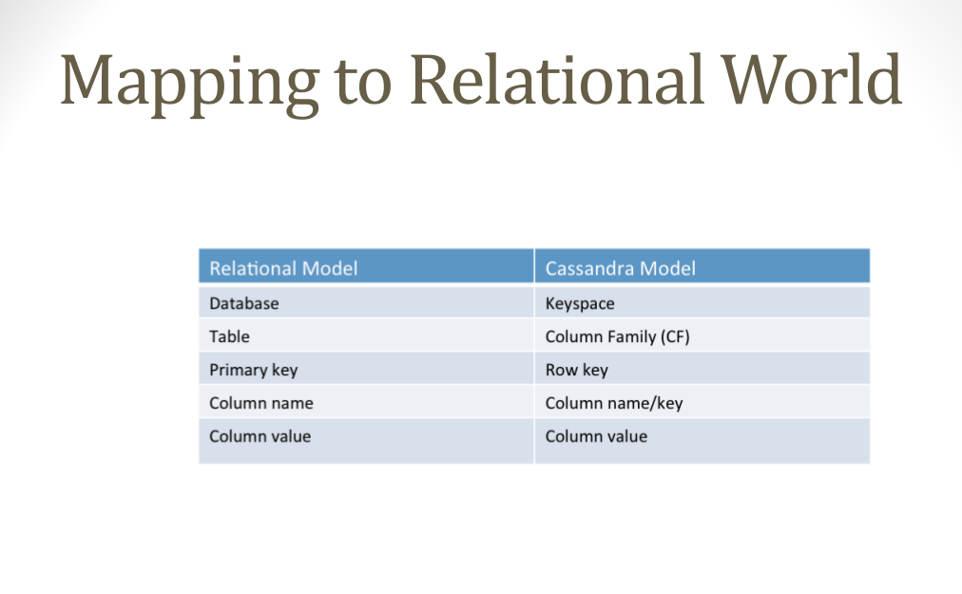

Slide 26
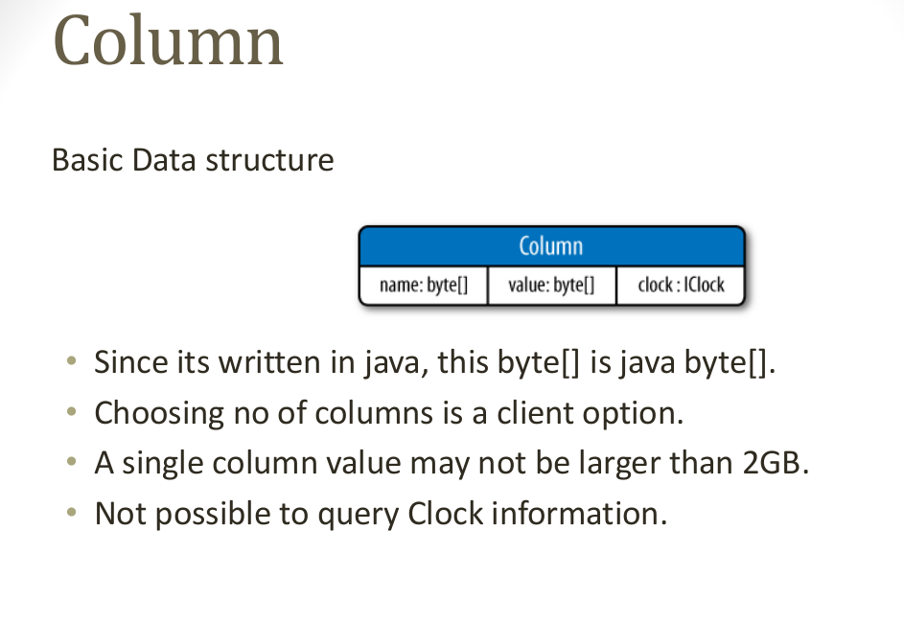

Slide 27
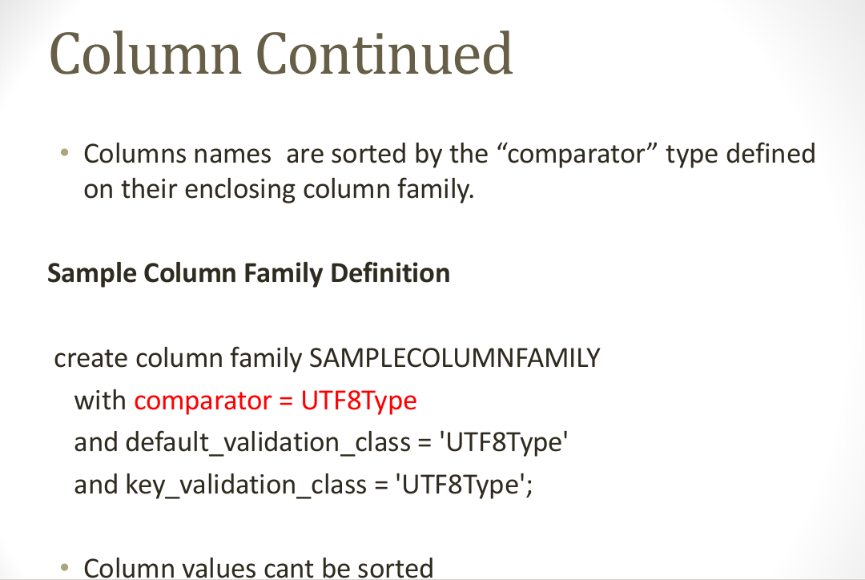

Slide 28
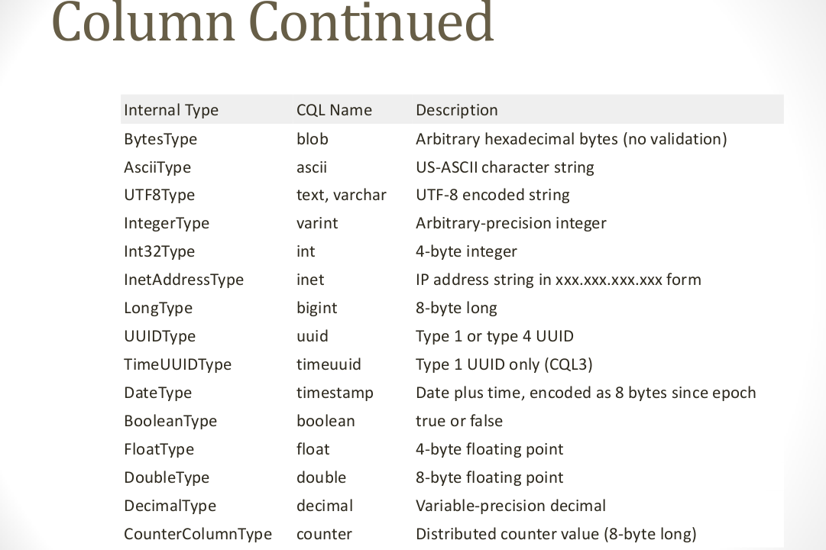
Source: datastax

Slide 29
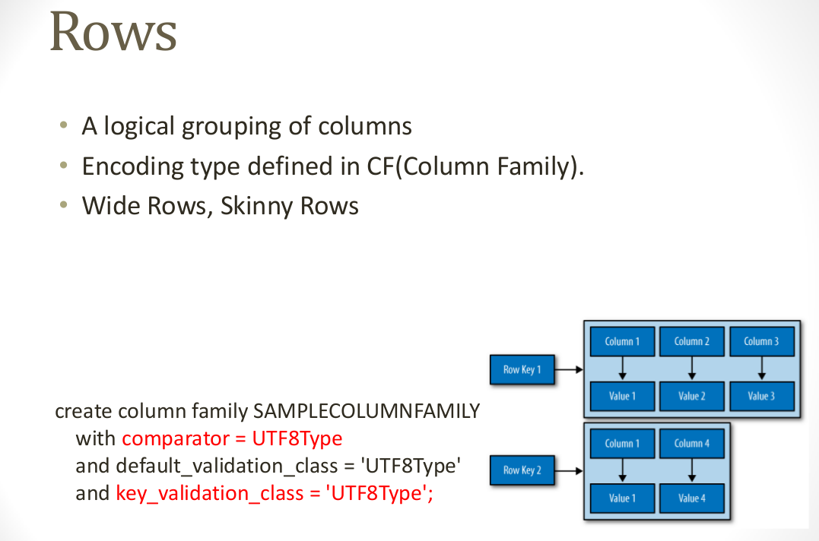

Slide 30
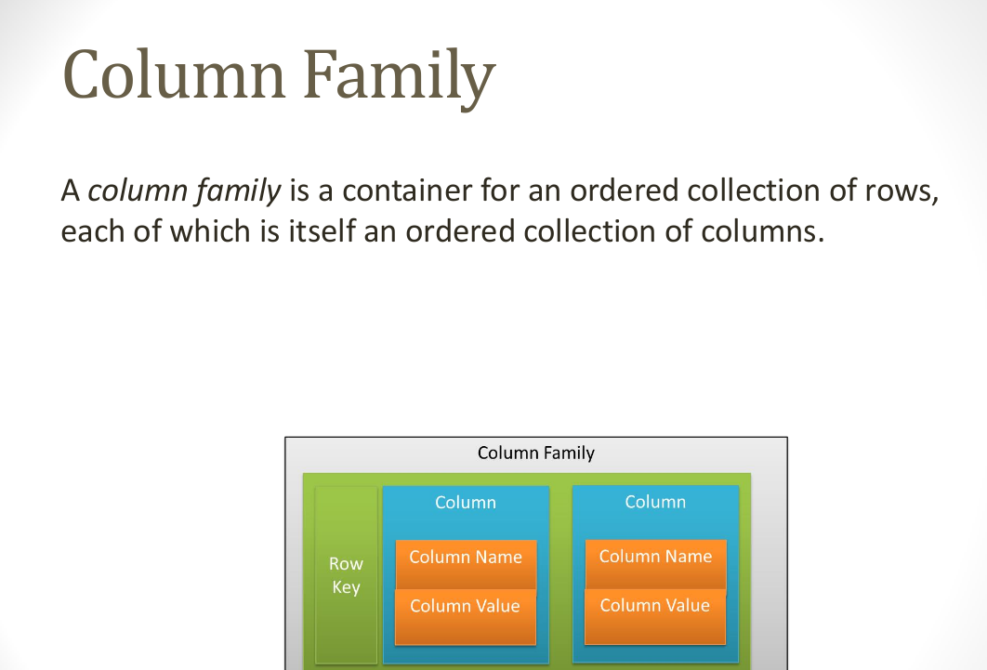

Slide 31
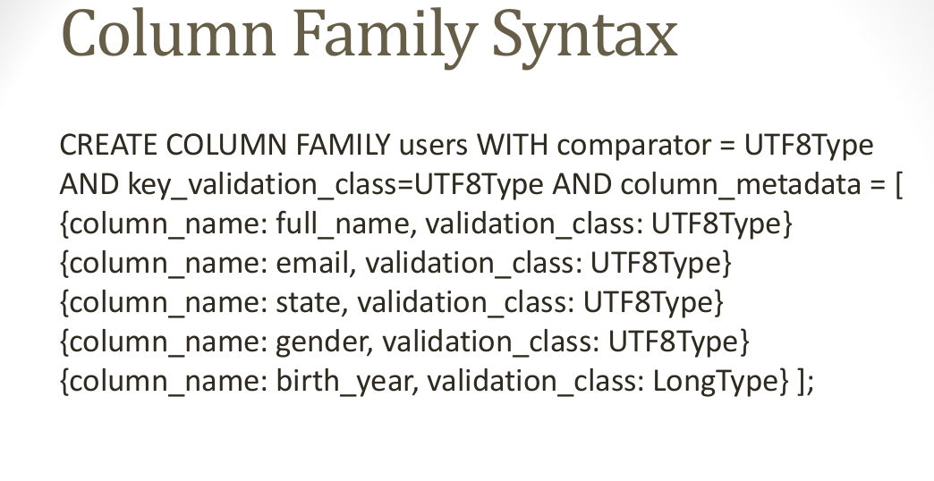

Slide 32
Read and Write in Cassandra

Slide 33
Read
Client
Query
Result
Cassandra Cluster
Closest replica
Result
Replica A
Digest Query
Replica B
Replica C

Slide 34
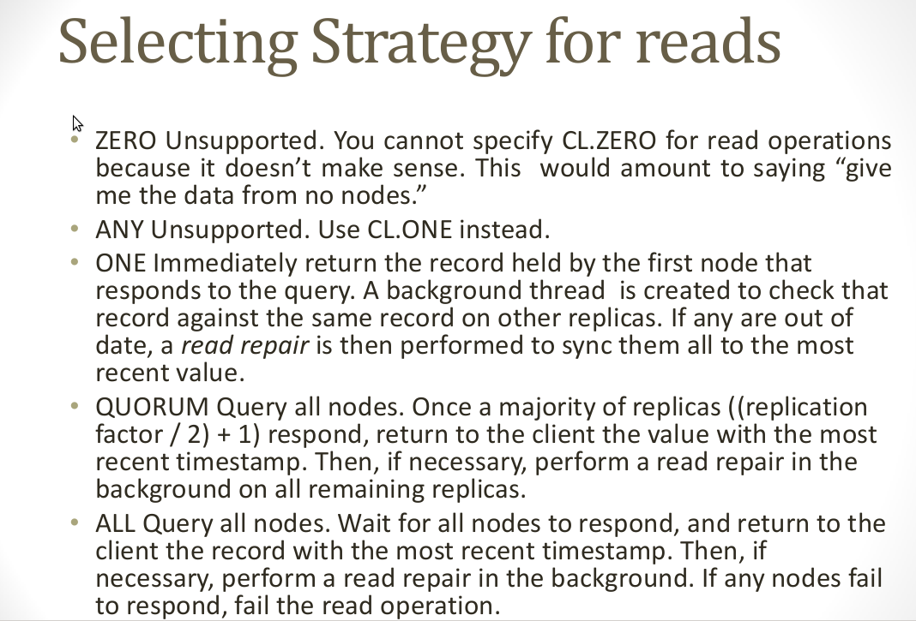

Slide 35
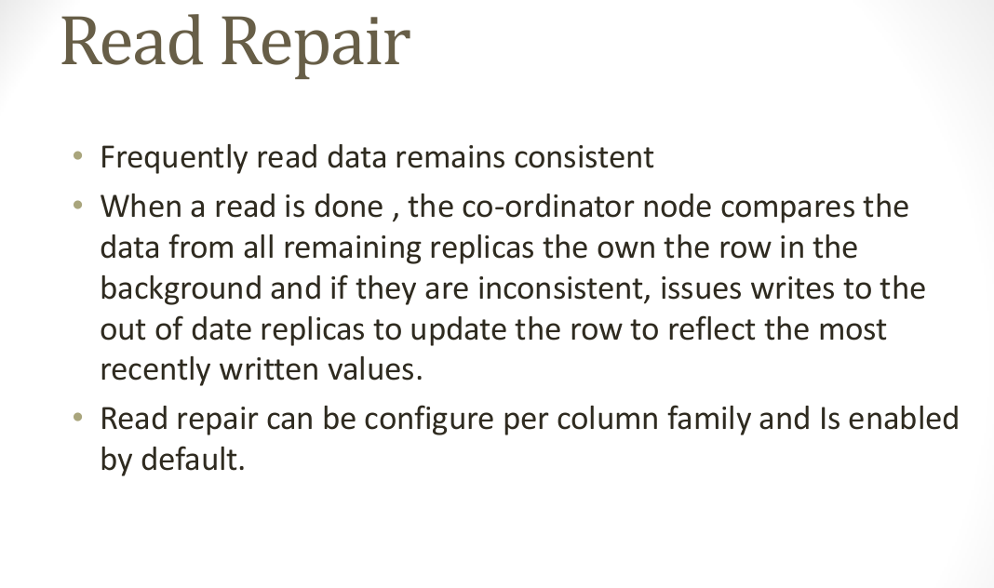

Slide 36
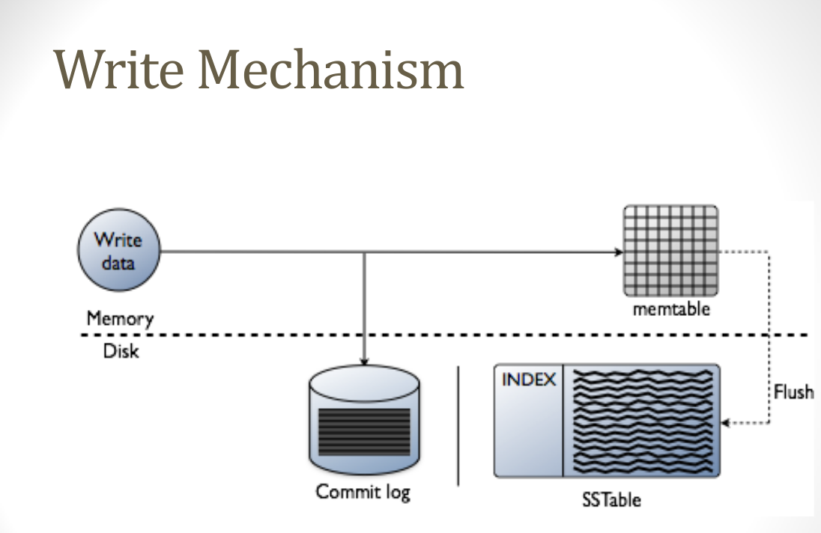

Slide 37
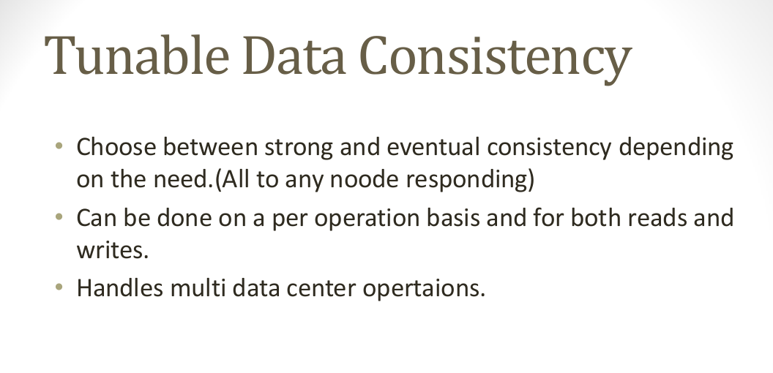

Slide 38
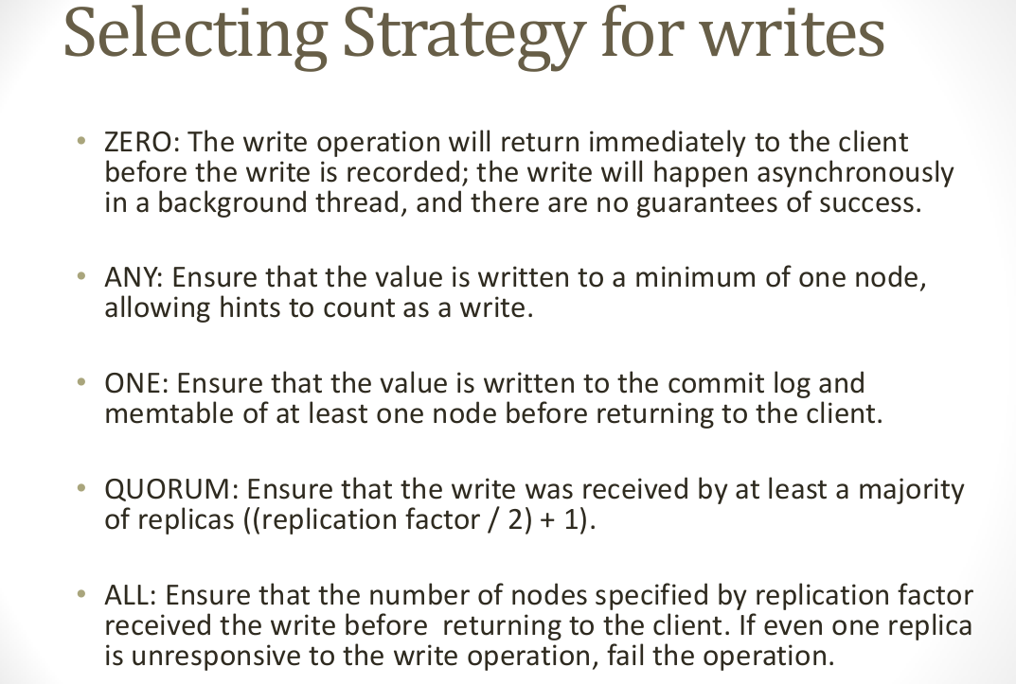

Slide 39
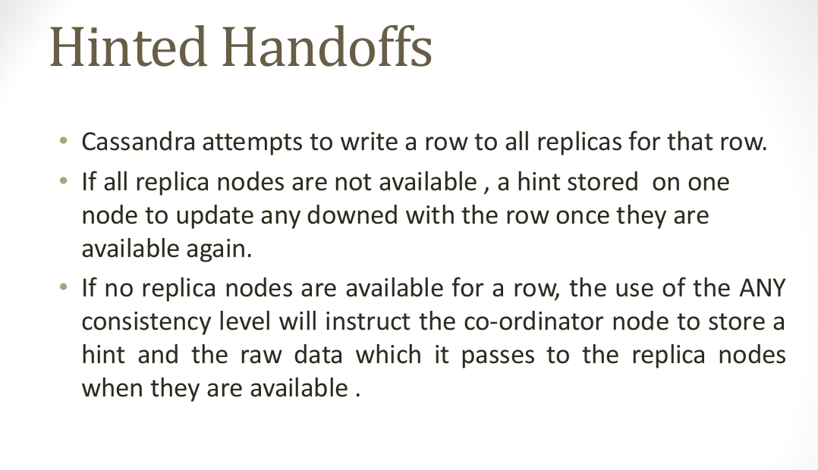

Slide 40
Writes
Need to be lock-free and fast (no reads or disk seeks)
Client sends write to one front-end node in Cassandra cluster (Coordinator)
Which (via Partitioning function) sends it to all replica nodes responsible for key
Always writable: Hinted Handoff
If any replica is down, the coordinator writes to all other replicas, and keeps the write until down replica comes back up.
When all replicas are down, the Coordinator (front end) buffers writes (for up to an hour).
Provides Atomicity for a given key (i.e., within ColumnFamily)
One ring per datacenter
Coordinator can also send write to one replica per remote datacenter

Slide 41
Writes at a replica node
On receiving a write
1. log it in disk commit log
2. Make changes to appropriate memtables
In-memory representation of multiple key-value pairs
Later, when memtable is full or old, flush to disk
Data File: An SSTable (Sorted String Table) – list of key value pairs, sorted by key
Index file: An SSTable – (key, position in data sstable) pairs
And a Bloom filter
Compaction: Data udpates accumulate over time and sstables and logs need to be compacted
Merge key updates, etc.
Reads need to touch log and multiple SSTables
May be slower than writes

Slide 42
Deletes and Reads
Delete: don’t delete item right away
add a tombstone to the log
Compaction will remove tombstone and delete item
Read: Similar to writes, except
Coordinator can contact closest replica (e.g., in same rack)
Coordinator also fetches from multiple replicas
check consistency in the background, initiating a read-repair if any two values are different
Makes read slower than writes (but still fast)
Read repair: uses gossip (remember this?)

Slide 43
Bootstrapping
When a node starts for the first time, it chooses a random token for its position in the ring.
Notes:
Rey=تکیه دارد substrate = لایه؛زیرلایه stage=مرحله؛وهله

Slide 44
Scaling The Cluster
When a new node is added into the system, it gets assigned a token such that it can alleviate a heavily loaded node.
Notes:
Rey=تکیه دارد substrate = لایه؛زیرلایه stage=مرحله؛وهله

Slide 45
Local Persistence
The Cassandra system relies on the local file system for data persistence.
Notes:
Rey=تکیه دارد substrate = لایه؛زیرلایه stage=مرحله؛وهله

Slide 46
Partitioning
One of the key design features for Cassandra is the ability to scale incrementally.
Notes:
Rey=تکیه دارد substrate = لایه؛زیرلایه stage=مرحله؛وهله

Slide 47
Partitioning and Replication
h(key1)
1
0
E
A
N=3
C
h(key2)
F
B
D
1/2
Notes:
47

Slide 48
Partitioning¹
In cassandra, the total data managed by the cluster is represented as a circular space or ring.
The ring is divided up into ranges equal to the number of nodes, which each node being responsible for one or more ranges of the overall data.
Before a node can join the ring, it must be assigned a token.
The token determines the node’s position on the ring and the range of data it is responsible for.
1 http://www.datastax.com/docs/0.8/cluster_architecture
Notes:
Role=نقش؛وظیفه

Slide 49
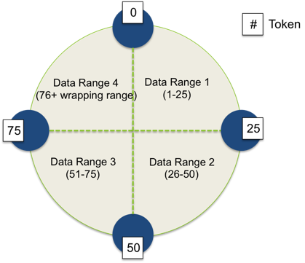
Partitioning – Single Data Center(Continue)¹
A cluster with 4 nodes, the row keys managed by the cluster were numbers in the range of 0 to 100.
Each node is assigned a token that represents a point in this range.
In this simple example, the token values are 0, 25, 50, and 75.
1 http://www.datastax.com/docs/0.8/cluster_architecture
Notes:
Responsible = مسئول , عهده دار

Slide 50
Partitioning – Replica Placement(Continue)¹
In multi-data center deployments, replica placement is calculated per data center.
Additional replicas in the same data center are placed by walking the ring clockwise until it reaches the first node in another rack.
1 http://www.datastax.com/docs/0.8/cluster_architecture
Notes:
Responsible = مسئول , عهده دار

Slide 51
Replication Factor & Replication In Cassandra
Replication factor The total number of replicas across the cluster is often referred to as the replication factor.
A replication factor of 1 means that there is only one copy of each row, and a replication factor of 2 means two copies of each row.
Replication Is the process of storing copies of data on multiple nodes.
Notes:
Morphs=بصورت پسوند میآید و بمعنی شکل ؛ ریخت figure out=discover

Slide 52
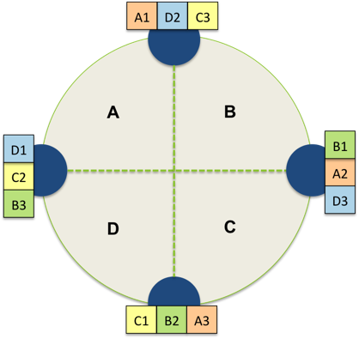
Replication Factor In Cassandra
Replication is the process of storing copies of data on multiple nodes.
Notes:
Morphs=بصورت پسوند میآید و بمعنی شکل ؛ ریخت figure out=discover

Slide 53
About Client Request
All nodes in cassandra are peers.
A client read/write request can go to any node in the cluster.
When a client connect to a node and issues a read/write request , that node serves as a proxy the coordinator for that particular operation.
The job of the coordinator is to act between the client application and the nodes(replicas)that own the data being requested.
Notes:
Morphs=بصورت پسوند میآید و بمعنی شکل ؛ ریخت figure out=discover

Slide 54
About Client Request(Continue)
The coordinator sends the write request to all replicas that own the row being written. If all replica nodes are up and available.
They will get the write regardless of the consistency level specified by the client.
The write consistency level determines how many replica nodes must respond with a success acknowledgement in order for the write to be considered successful.
Notes:
Morphs=بصورت پسوند میآید و بمعنی شکل ؛ ریخت figure out=discover

Slide 55
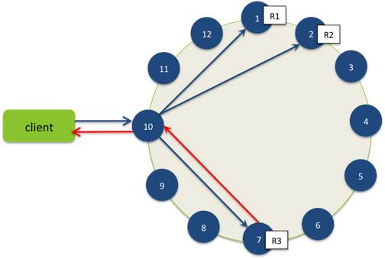
An Example To Write
For example, in a single data center 10 node cluster with a replication factor of 3, an incoming write will go to all 3 nodes that own the requested row.
Notes:
Morphs=بصورت پسوند میآید و بمعنی شکل ؛ ریخت figure out=discover regardless = صرفنظر از

Slide 56
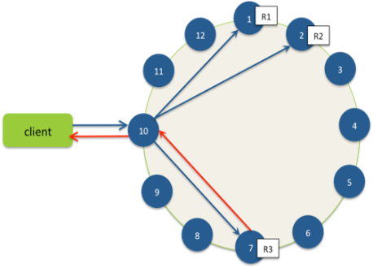
R1
1
R2
12
2
11
3
Client
10
4
5
9
8
6
7
R3

